Slide 1
Natural Language Processing
(based heavily on Dr. Pham Quang Nhat Minh’s 2016 lecture, “Introduction to Natural Language Processing”)
Lecture 3
CSCI 8360

Slide 2

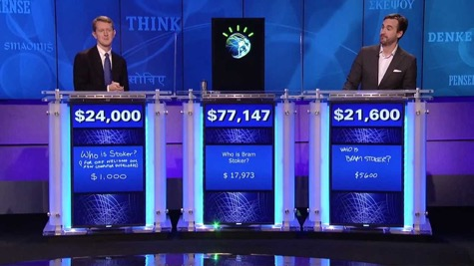
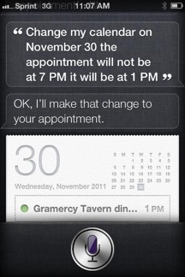
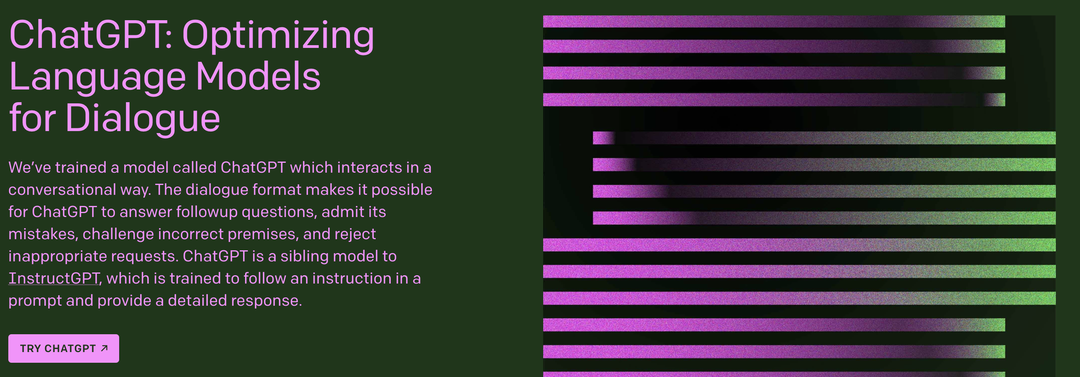
Google “natural language processing”

Slide 3
What is NLP?
A field of computer science, artificial intelligence, and computational linguistics
To get computers to perform useful tasks involving human languages
Human-machine communication
Machine translation
Extracting information from text

Slide 4
Why NLP?
Languages pervades almost all human activities
Reading, writing, speaking, listening…
Voice-actuated interfaces
Remote controls, virtual assistants, accessibility…
We have tons of text data
Social networks, blogs, electronic health care records, publications…
NLP bridges all these areas to create interesting applications
NLP is challenging!

Slide 5
Why is NLP Challenging?
Language is ambiguous
From Jurafsky book: “I made her duck” could mean
I cooked waterfowl for her.
I cooked the waterfowl that belongs to her.
I created the (plaster?) duck she owns.
I caused her to quickly lower her head or body.
I waved a magic wand and turned her into waterfowl.
Nevermind the infamous “Buffalo buffalo Buffalo buffalo buffalo buffalo Buffalo buffalo”…

Slide 6
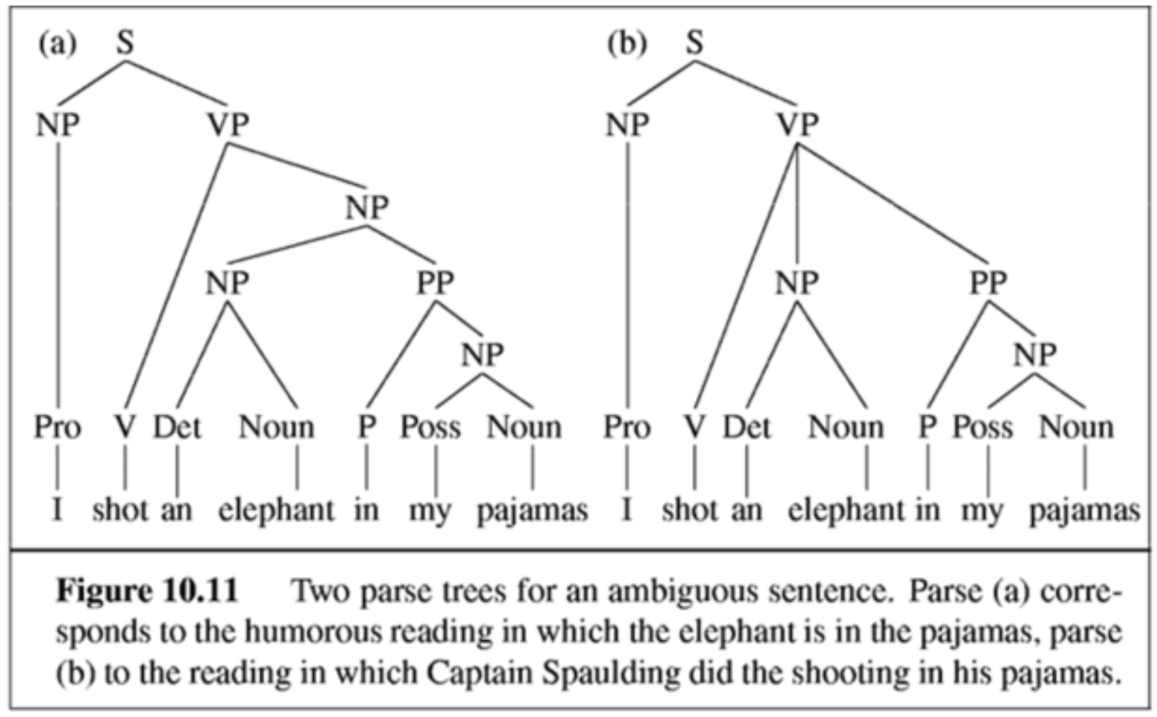
Why is NLP Challenging?
“I shot an elephant in my pajamas.”

Slide 7
Why is NLP Challenging?
Ambiguity of language exists at every level
Lexical (word meaning)
Syntactic
Semantic
Discourse (conversations)
Natural languages are fuzzy
Natural languages rely on a priori knowledge of the surrounding world
E.g., it is unlikely that an elephant will wear pajamas

Slide 8
Brief History of NLP
1940s and 1950s
Foundational insights
Automaton
Probabilistic and information-theoretic models
1957-1970
Two camps: symbolic (Chomsky et al, formal language theory and generative syntax) and stochastic (pure statistics)
1970-1983
Four paradigms, explosion in research into NLP
Stochastic, logic-based, natural language understanding (knowledge models), discourse modeling
1983-1993
Empiricism and finite state models, redux
1994-1999
The fields come together: probabilistic and data-driven models become the standard
2000-present
The Rise of the Planet of the Crystal Skull of Machine Learning
Large amount of digital data available
Widespread availability of high-performance computing hardware

Slide 9
Common NLP Tasks
Notes:
Name some common NLP tasks & how hard you think they are

Slide 10
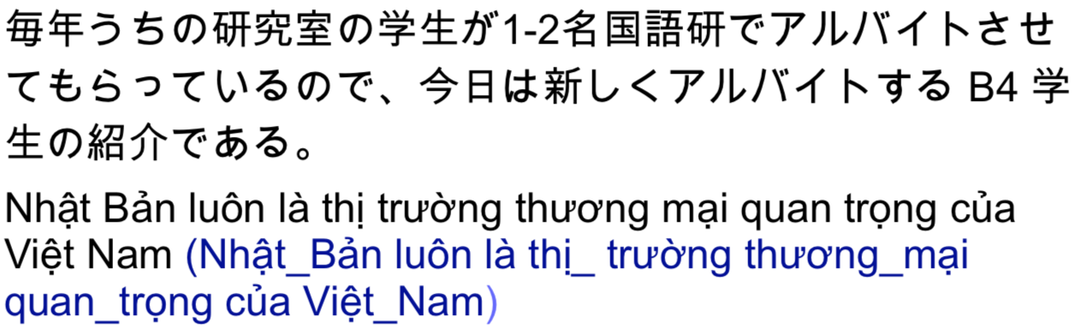
Word Segmentation
In some languages, there’s no space between words, or a word may contain smaller symbols
In such cases, word segmentation is the first step in any NLP pipeline

Slide 11
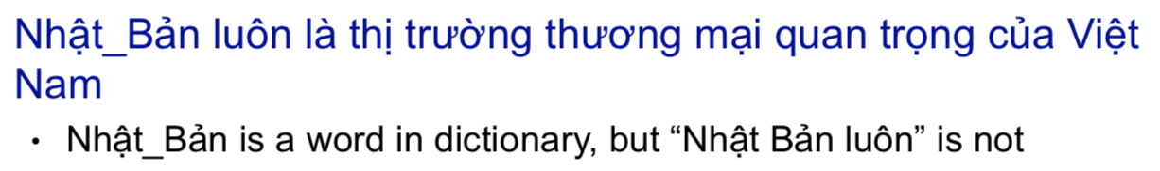
Word Segmentation
A possible solution is maximum matching
Start by pointing at the beginning of a string, then choose the longest word in the the dictionary that matches the input at the current position
Problems:
Maxmatching can’t deal with unknown words
Dependency between words in the same sentences is not exploited

Slide 12
Word Segmentation
Most successful word segmentation tools are based on ML techniques
Word segmentation tools obtain a high accuracy
vn.vitk (https://github.com/phuonglh/vn.vitk) obtained 97% accuracy on test data
Not necessarily a problem with whitespace-delimited languages (like English) but still have corner cases

Slide 13
POS Tagging
Each word in a sentence can be classified in to classes, such as verbs, adjectives, nouns, etc
POS Tagging is a process of tagging words in a sentences to particular part-of-speech, based on:
Definition
Context
The/DT grand/JJ jury/NN commented/VBD on/IN a/DT number/NN of/IN other/JJ topics/NNS ./.

Slide 14
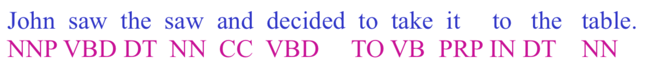
Sequence Labeling
Many NLP problems can be viewed as sequence labeling
Each token in a sequence is assigned a label
Labels of tokens are dependent on the labels of other tokens in the sequence, particularly their neighbors

Slide 15
Probabilistic sequence Models
Model probabilities of pairs (token sequences, tag sequences) from annotated data
Exploit dependency between tokens
Typical sequence models
Hidden Markov Models (HMMs)
Conditional Random Fields (CRF)

Slide 16
Syntax Analysis
The task of recognizing a sentence and assigning a syntactic structure to it
An important task in NLP with many applications
Intermediate stage of representation for semantic analysis
Play an important role in applications like question answering and information extraction
E.g., What books were written by British women authors before 1800?

Slide 17
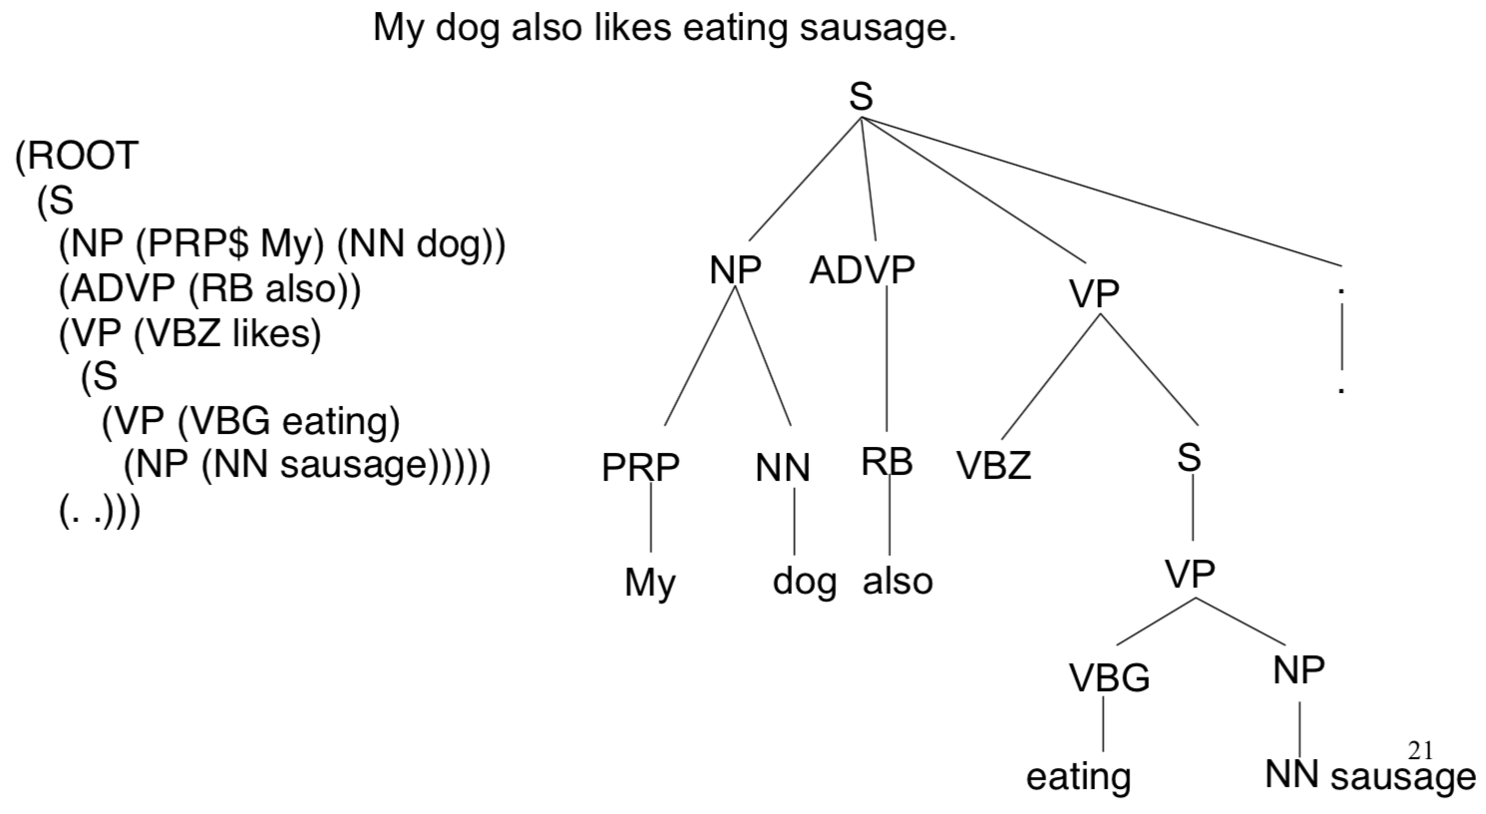
Syntax Analysis

Slide 18
Approaches to Syntax Analysis
Top-down parsing
Bottom-up parsing
Dynamic programming methods
CYK algorithm
Earley algorithm
Chart parsing
Probabilistic Context-Free Grammars (PCFG)
Assign probabilities for derivations

Slide 19
Semantic Analysis
Two levels
Lexical semantics
Representing meaning of words
Word sense disambiguation (e.g., word bank)
Compositional semantics
How words combined to form a larger meaning.

Slide 20
Semantic Analysis Techniques
Bag-of-words
Word order doesn’t matter, only word frequency
Works surprisingly well in practice (e.g., Naïve Bayes)
Fails hilariously at times (word order does matter, stop words, etc)

Slide 21
Semantic Analysis Techniques
TF-IDF
Slight modification on standard bag-of-words
Includes an inverse document frequency term to offset effects of stopwords
Works even better in practice
Term counts are now document-specific

Slide 22
Semantic Analysis Techniques
Latent Semantic Analysis (LSA)
Basically matrix factorization of term frequencies
Pulls out semantic “concepts” present in the documents
Sometimes “concepts” defy intuitive interpretation

Slide 23
Semantic Analysis Techniques
Latent Dirichlet Allocation (LDA)
Explicitly models topic distributions even within the same document
Generative model that can “simulate” documents belonging to a single topic
Really hard to train
Topics again defy intuitive interpretation

Slide 24
Semantic Analysis Techniques
Word embeddings
word2vec, doc2vec, GloVe
Build a vector representation of a word
Define it by its context (neighboring words)
Can perform “word algebra”
Embeddings dependent on corpus used to train them

Slide 25
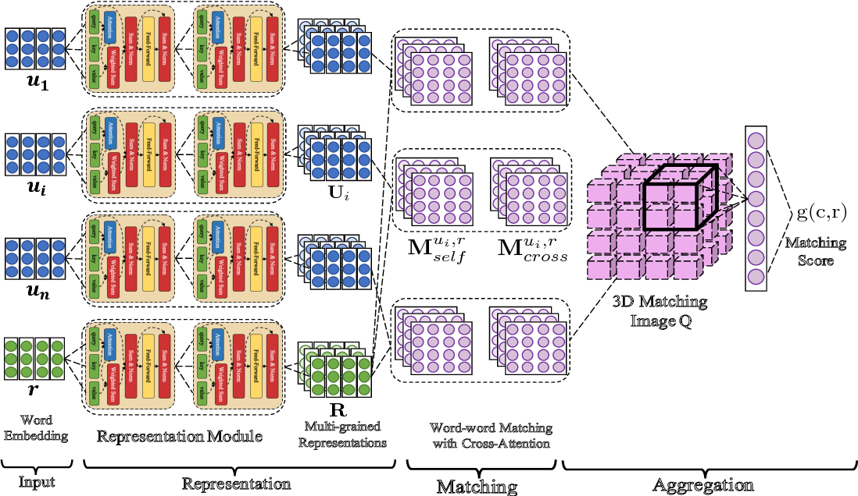
Semantic Analysis Techniques
Large Language Models (LLMs)
Sometimes [ridiculously] referred to as “Foundation Models”
Huge neural models (billions of neurons) + huge text datasets (petabytes) + relatively straightforward word embeddings and representation matching
Examples GPT-3, ChatGPT, Copilot
True breakthrough is scale

Slide 26
A note on Stopwords
Removing stopwords: Good, Bad, or Maybe?
If you’re trying to understand content, removing stopwords is generally good
Spam filtering
Article tagging
Clustering
If you’re trying to understand semantics, removing stopwords is generally bad
Author recognition
Machine translation
Style transfer

Slide 27
References
“Introduction to natural language processing”, https://www.slideshare.net/minhpqn/introduction-to-natural-language-processing-67212472
NLP slides from Stanford Coursera course https://web.stanford.edu/~jurafsky/NLPCourseraSlides.html

Slide 28
Questions?

Slide 29
Project 0
Out tomorrow!
Due Monday, January 23, by 11:59:59pm (AutoLab will shut down after)
Can’t use nltk, breeze, or other NLP-specific packages
Really, you won’t need them
Spark / Dask, & “NLP”
Count words in documents (term frequencies)
Incorporate stopword filtering (will need broadcast variables for this)
Truncate out punctuation
Implement TF-IDF for improved word counting
CANNOT STORE VOCABULARY LOCALLY. Need to distribute / parallelize!

Slide 30
Project 0
Pay attention to the requirements of the deliverables
Name GitHub repo correctly
Incorrectly-named or formatted JSON files will cause autograder to fail
Include README and CONTRIBUTORS files
Practice using git (commit, push, branch, merge) and GitHub functionality (issues, milestones, pull requests)

Slide 31
AutoLab
1. You’ll need to create an account on AutoLab
autolab.cs.uga.edu
2. …and I’ll need to add you to the 8360 course
Once #1 and #2 above are true, you should be able to submit outputs from your program according to the instructions to AutoLab for grading
If the format of the submission is correct, you should see a ranking appear on the leaderboard!
If not, double-check the format of your submission.
If you’re still having problems, post in #techprobs on Discord

Slide 32
Quick Reference from Lecture 2
Need help with learning git? https://try.github.io/
Specifically, need help with git branching? https://learngitbranching.js.org/
Web-based, interactive, highly-visual walkthroughs
Highly recommend, even if you’ve used git before

